Slide 1
Topics to be covered
8255
ADC
DAC
8253
8251
80286
80386
80586

Slide 2
8255: Programmable Peripheral Interface
It is used as an interface between processor and I/O devices.
8086
Micro-processor
8255
PPI
I/O
Devices

Slide 3
Features of 8255
It has three 8-bit bi-directional I/O ports: Port A, Port B, and Port C.
It provides 3 modes of data transfer:
1) Mode0: Simple I/O
2) Mode1: Handshake I/O
3) Mode2: Bi-directional Handshake.
Additionally it also provides a Bit Set Reset Modes to alter individual bits of Port C.

Slide 4
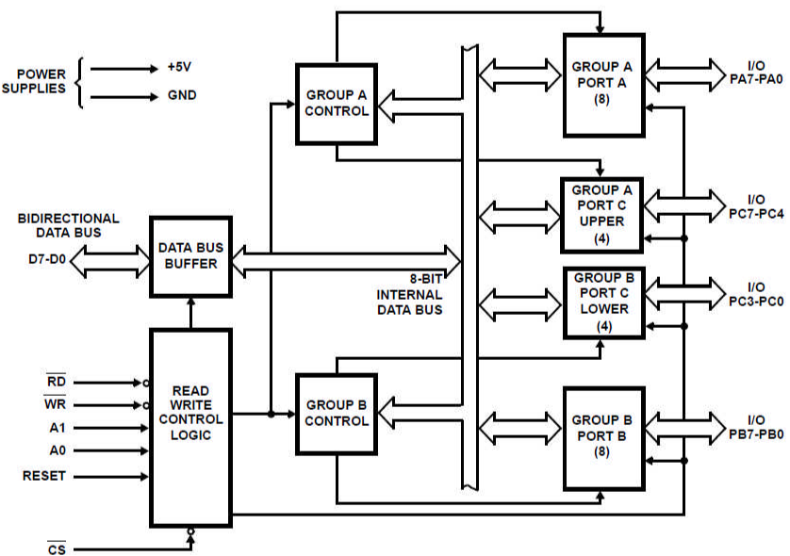
ARCHITECTURE OF 8255

Slide 5
Data Bus Buffer
This is a 8-bit bi-directional buffer used to interface the internal data bus of 8255 with the external (system) data bus.
The CPU transfers data to and from the 8255 through this buffer.
Read/Write Control Logic
It accepts address and control signals from the µP.
The Control signals determine whether it is a read or a write operation and also select or reset the 8255 chip.
Group A Control
This Control block controls Port A and Port C_{Upper} i.e. PC₇-PC₄.
It accepts Control signals from the Control Word and forwards them to the respective Ports.
Group B Control
This Control block controls Port B and Port C_{Lower} i.e. PC₃-PC₀.
It accepts Control signals from the Control Word and forwards them to the respective Ports.

Slide 6
The Address bits (A2, A1) of 8086 microprocessor are connected to A1 and A0 of 8255 to select the Ports or the Control Word Register.
A7 | A6 | A5 | A4 | A3 | A2 | A1 | A0 | Address | Selection
1 | 0 | 0 | 0 | 0 | 0 | 0 | 0 | 80 | PA
1 | 0 | 0 | 0 | 0 | 0 | 1 | 0 | 82 | PB
1 | 0 | 0 | 0 | 0 | 1 | 0 | 0 | 84 | PC
1 | 0 | 0 | 0 | 0 | 1 | 1 | 0 | 86 | CW

Slide 7
Modes of 8255
D7th bit of Control Word
0: BSR MODE
1: IO MODE
Mode mode Mode
0 1 2

Slide 8
Modes of 8255
Port | Mode 0 | Mode 1 | Mode 2
Port A | Yes | Yes | Yes
Port B | Yes | Yes | No (Mode 0 or Mode 1)
Port C | Yes | No (Handshake signals) | No (Handshake signals)

Slide 9
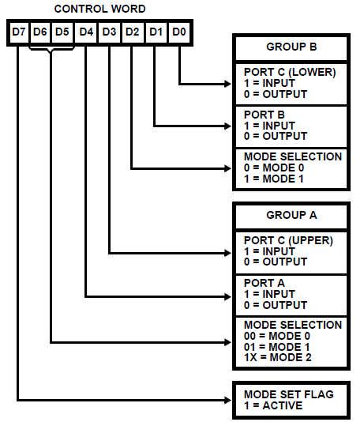
CONTROL WORD OF
8255:
IO MODE
Ex: PA: Input port, mode2 PB: Output port, mode1 PC: Input port, mode0
1 | 1 | 0 | 1 | 1 | 1 | 0 | 1

Slide 10
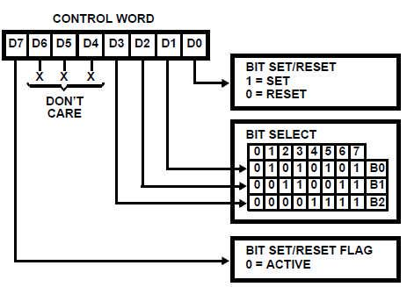
CONTROL WORD OF
8255:
BSR MODE used to set or reset the bits in PC
Ex: PC5: set
0 | 0 | 0 | 0 | 1 | 0 | 1 | 1

Slide 11
Mode 0: Simple Bi-directional I/O
Port A and Port B used as 2 Simple 8-bit I/O Ports.
Port C is used as 2 simple 4-bit I/O Ports.
Each port can be programmed as input or output individually.
Ports do not have handshake or interrupting capability.
Mode 1 (Handshake I/O)
In Mode 1, handshake signals are exchanged between the devices before the data transfer takes place.
Port A and Port B used as 2 8-bit I/O Ports that can programmed in Input OR in output mode.
Each Port uses 3 lines from Port C for handshake. The remaining lines of Port C can be used for simple IO.

Slide 12
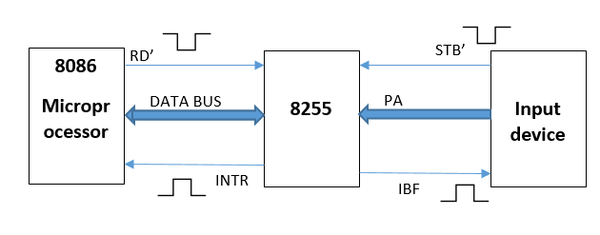
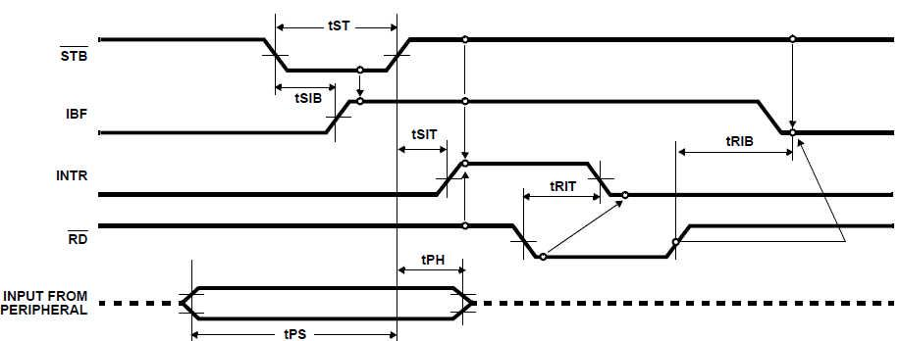
MODE1: INPUTHANDSHAKING
Timing Diagram for Mode 1 Input Transfer

Slide 13
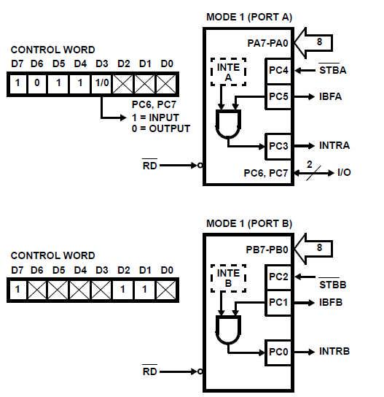
MODE1: INPUTHANDSHAKING

Slide 14
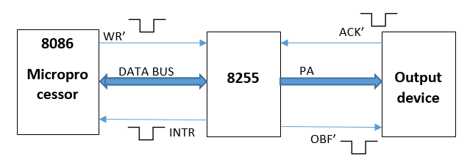
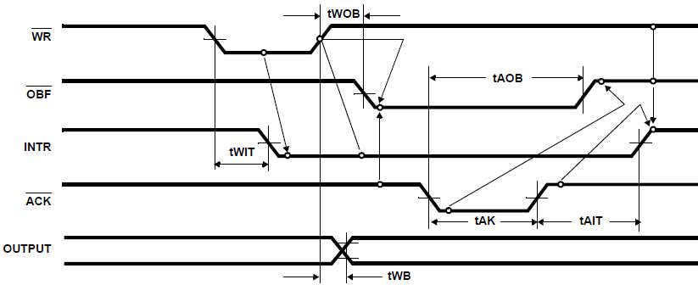
MODE1:OUTPUTHANDSHAKING
Timing Diagram for Mode 1 Output Transfer

Slide 15
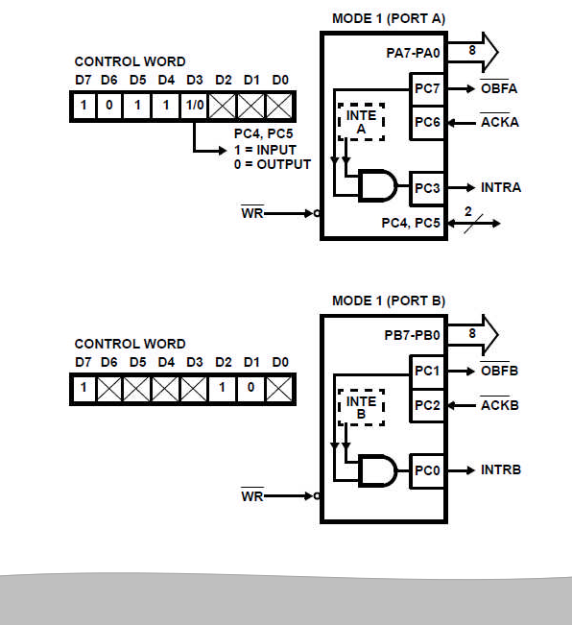
MODE 1:
OUTPUT
HANDSHAKING

Slide 16
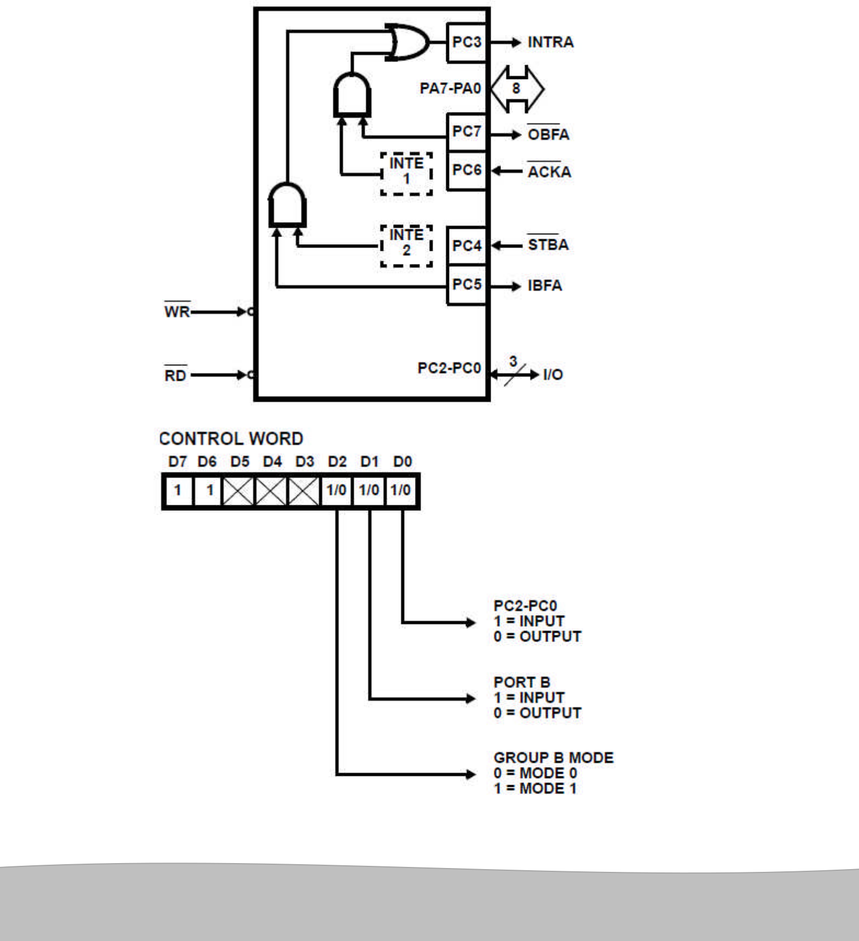
MODE 2:
BIDIRECTIONAL
HANDSHAKING
Only Port A can operate in Mode 2.
At that time Port B can operate in Mode 1 or Mode 0.
Port C lines are again used up for performing Handshaking for Port A and Port B.

Slide 17
ADC 0808
ADC 0808 is an 8 channel, 8 bit ADC. It can convert an analog voltage input into an 8 bit digital data output.
To select an input out of 8 options, there are three select lines (C, B and A). We put a channel number on these lines (0…7) and latch it using ALE. (Once the channel is set, it should be enabled by making ALE high.)
SOC signal is given to ADC indicate start of conversion.
The end of conversion is indicated by the ADC using EOC signal.
Now give OE signal for enabling 8-bit data output from the ADC to 8255.
This data from 8255 is now transferred to the microprocessor. The process is repeated for subsequent channels, by changing the channel number. ADCs have a vast use in the modern electronic world for Data Acquisition Systems. They can be used for temperature sensing, voice recording, speed sensing

Slide 18
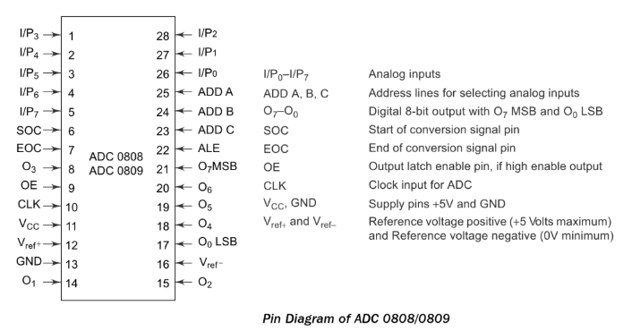
PIN DIAGRAM OF ADC 0808

Slide 19
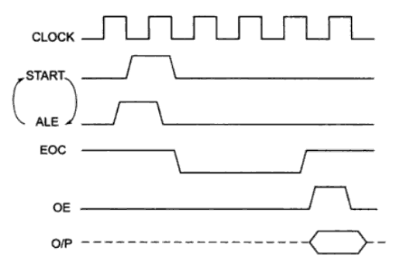
Channel Selection
Timing diagram of ADC0805
Address Lines |  |  | Analog input selected
C | B | A
0 | 0 | 0 | I/P0
0 | 0 | 1 | I/P1
0 | 1 | 0 | I/P2
0 | 1 | 1 | I/P3
1 | 0 | 0 | I/P4
1 | 0 | 1 | I/P5
1 | 1 | 0 | I/P6
1 | 1 | 1 | I/P7

Slide 20
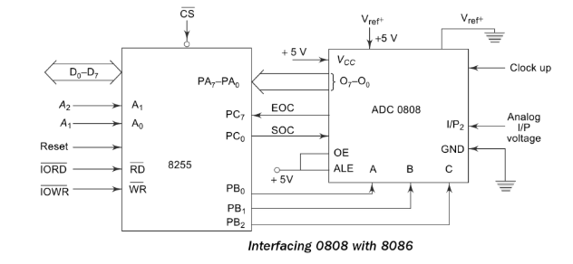
Interfacing of ADC0808 with 8086

Slide 21
PA: to read digital data from ADC
PB: to select the channel
PC0: SOC
PC7: EOC
 | MOV AL, 98H | Initialise 8255 as
 | OUT CWR, AL
 | MOV AL,02H | Selected I/P 2 as analog input
 | OUT PORTB, AL
 | MOV AL, 00 H | Give Start of conversion Pulse to the ADC
 | OUT PORTC, AL
 | MOV AL, 01 H
 | OUT PORTC, AL
 | MOV AL, 00 H
 | OUT PORTC, AL
WAIT: | IN AL, PORTC | Check for EOC by reading port C upper and rotating through carry
 | RCL
 | JNC WAIT
 | IN AL, PORTA | If EOC, read digital equivalent is AL
 | HLT | Stop
IO | PA MODE |  | PA | PCU | PB MODE | PB | PCL
1 | 0 | 0 | 1 | 1 | 0 | 0 | 0

Slide 22
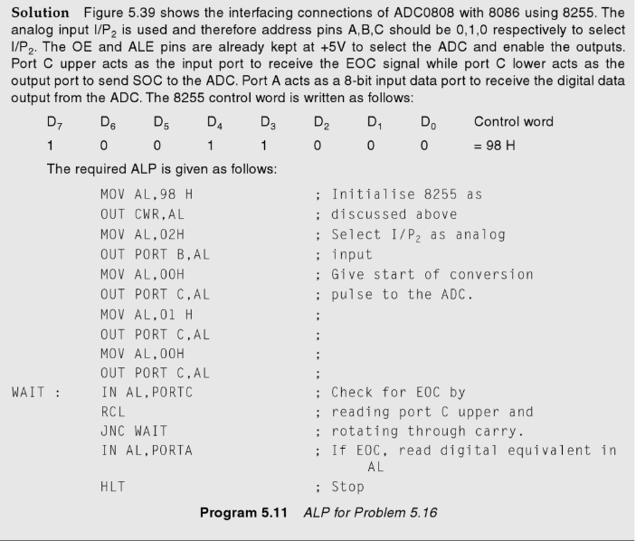

Slide 23
DAC 0808
DAC 0808 is an 8 bit Digital to Analog Converter. It can convert an 8 bit digital data input into an analog voltage output.
Reference voltage for conversion is provided using +Vref and –Vref. The output can be amplified (optional) using an op-amp.
DACs are used in various applications such as Waveform generation, PWM, Motor control Applications, DSP etc. Here we connect the output to a display device like a CRO.
The output from 0808 DAC is current, so we need current to voltage converter at output of DAC.

Slide 24
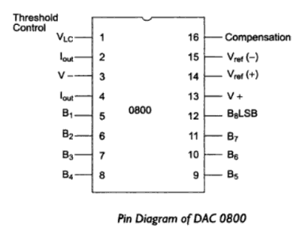
Pin diagram of DAC0808

Slide 25
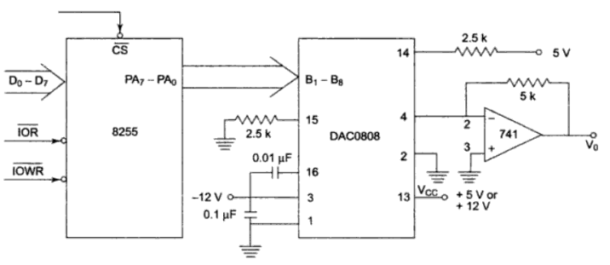
Interfacing of DAC0808 with 8086

Slide 26
 | MOV AL, 80 H | Configure PA as output port
 | OUT 46, AL
REPT: | MOV AL, 00 H | Start rising ramp from 0 to 2.5V i.e. 7F and send it to PA
BACK: | OUT 40, AL
 | INC AL
 | CMP AL, 7 FH
 | JNZ BACK | If ramp reaches 2.5V, then come out of loop
 | MOV AL, FFH | generate step of 5V for 5msec
 | OUT 40, AL
 | CALL DELAY
 | MOV AL, 7FH | Generate falling ramp from 2.5v to 0V
BACK 1: | OUT 40, AL
 | DEC AL
 | CMP AL, 00H
 | JNZ BACK1
 | JMP REPT
DELAY: | OUT 4, AL
BACK2: | INC BX
 | CMP BX, 04E2 H
 | JNZ BACK2

Slide 27
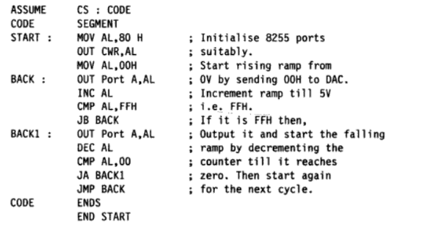

Slide 28
8253: Programmable Interval Timer
Features of 8253:
8253 is used as a timer to generate time delay or as a counter.
Three independent 16-bit down counters.
Three counters can be programmed for either binary or BCD count
Counter can be programmed in six different modes.

Slide 29
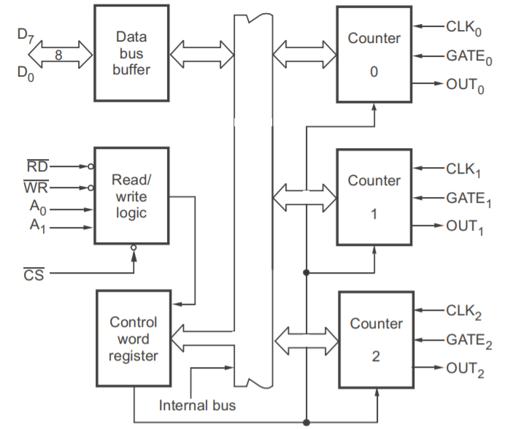
Architecture of 8253

Slide 30
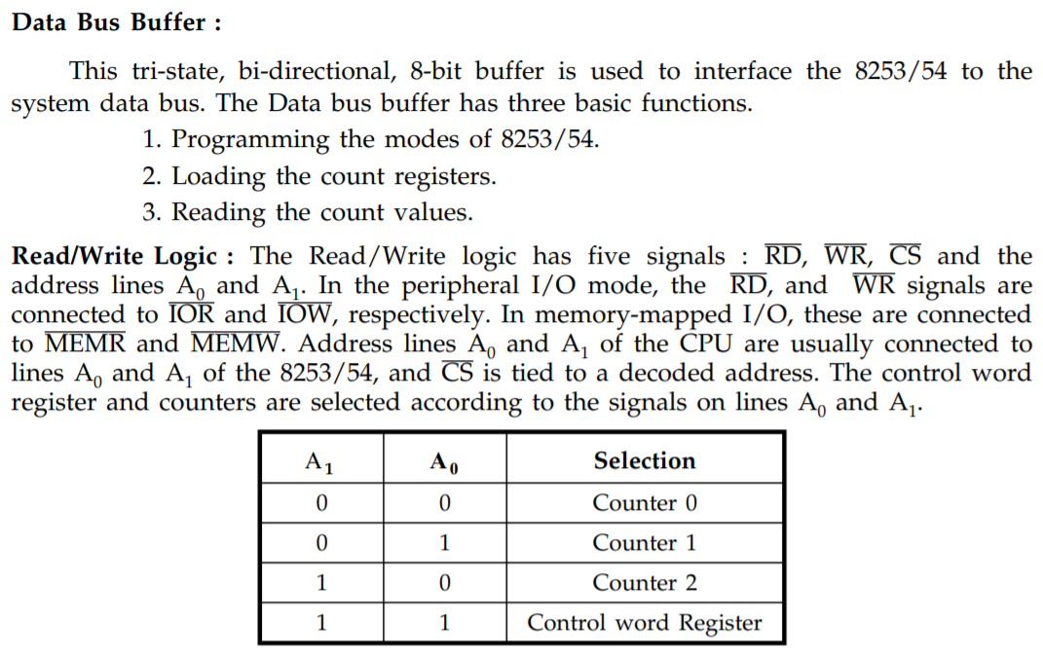

Slide 31
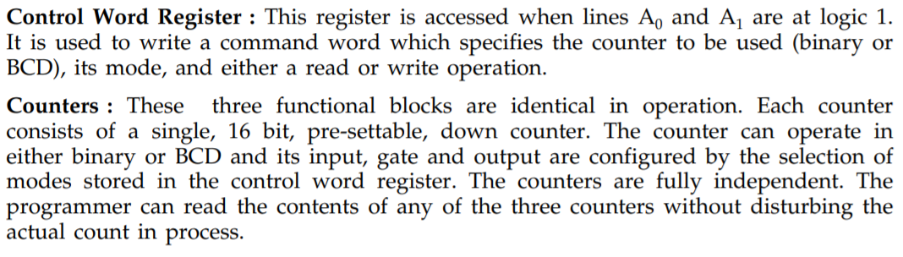
Each counter has the following signals:
  Clk (Clock Input)
  Gate(Gate Input)
  Out (Clock Output)
The input clock signal is applied on the CLK line.
The counter decrements the "count value" on every pulse of the input clock at CLK.
When the count becomes zero (Terminal Count i.e. TC), the status of the OUT pin changes. This can be used to interrupt the µP.
The GATE pin is used to control the Counting.
In most modes, the count value gets decremented only if the GATE pin is high.

Slide 32
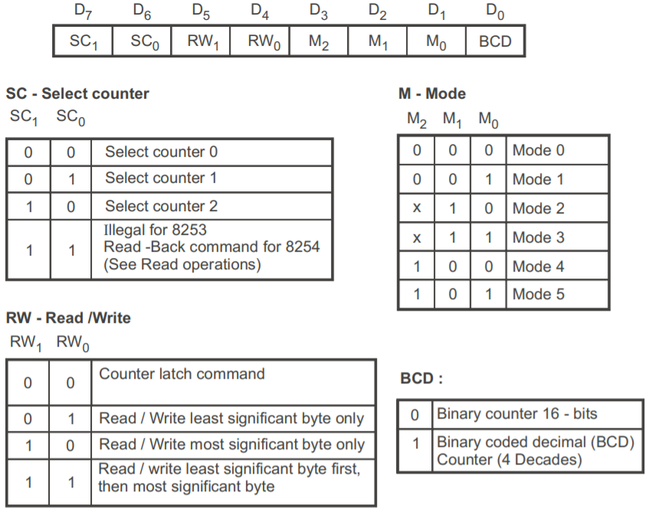
Control
Word
Register

Slide 33
Modes of 8253
Mode0: Interrupt on terminal count
Mode1: Mono stable multivibrator
Mode2: Rate generator
Mode3: Square wave generator
Mode4: Software triggered strobe
Mode5: Hardware triggered strobe

Slide 34
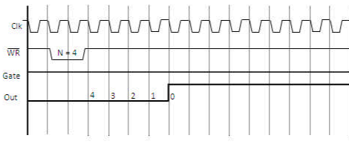
Mode0: Interrupt on terminal count

Slide 35
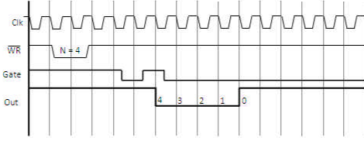
Mode1: Mono stable multivibrator

Slide 36
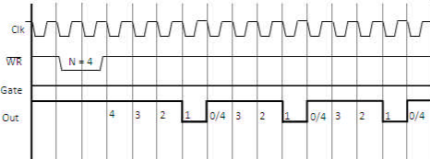
Mode2: Rate generator

Slide 37
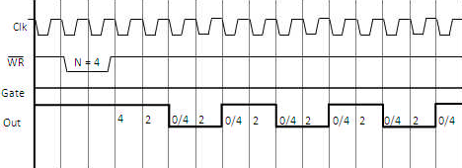
Mode3: Square wave generator

Slide 38
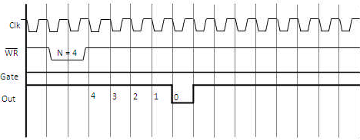
Mode4: Software triggered strobe

Slide 39
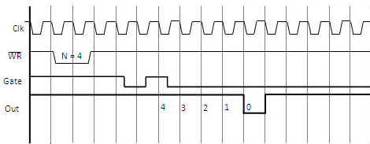
Mode5: Hardware triggered strobe

Slide 41
Features of 80286
It is a 16 bit Microprocessor
It has a 16 bit data bus.
It has 2 memory banks.
It has a 24 bit address bus.
It can access 16 MB memory.
It has 3 Pipeline stages - Fetch, Decode, Execute.
It operates on 6 MHz – 12 MHz frequency.

Slide 42
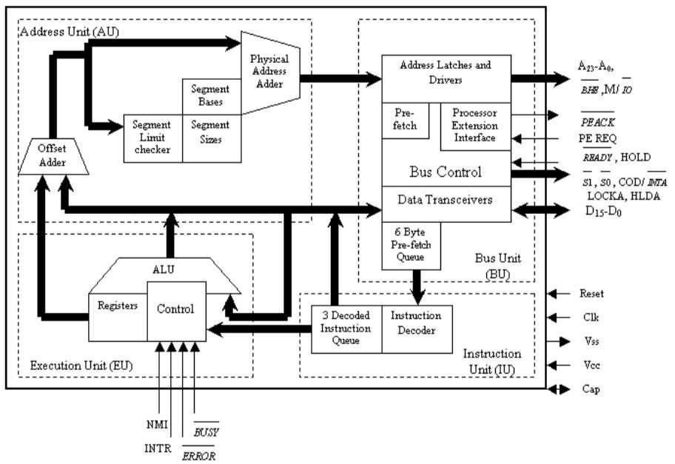
Architecture of
80286

Slide 43
Features of 80386
It is a 32 bit Microprocessor.
It has a 32 bit data bus.
It has 4 memory banks.
It has a 32 bit address bus.
It can access 4 GB memory.
It has 3 Pipeline stages- Fetch, Decode, Execute.
It operates on 16 MHz – 33 MHz frequency.

Slide 44
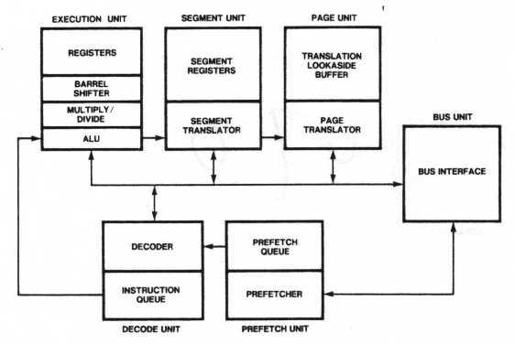
Architecture of
80386

Slide 45
Features of 80586
It is a 32 bit Microprocessor.
It has a 64 bit data bus.
It has 8 memory banks.
It has a 32 bit address bus.
It can access 4 GB of physical memory.
It has 5 Pipeline stages for integer operations.
It has an internal Floating point unit.
It has an 8 stage Floating point Pipeline.
It is 2 way superscalar. This means it has two pipes called the u-pipe and the v-pipe.
It operates on 66 MHz – 99 MHz frequency.
The Integer Pipeline stages are called: PF – Prefetch; D1 – Decode; D2 – Address Translation; EX – Execute; WR – Write Back.
It has a protection mechanism with 4 privilege levels.
It has on-chip L1 Code cache and L1 Data Cache both 8 KB each.
It has a branch prediction logic with a 256 entry Branch Target Buffer (BTB).

Slide 46
Comparison of 8086, 80286, 80386 and 80586
S No | Attribute | 8086 | 80286 | 80386 | 80586
1 | Processor Size | 16 – bit | 16 – bit | 32 – bit | 32 – bit
2 | Data Bus | 16 – bit | 16 – bit | 32 – bit | 64 – bit
3 | Memory Banks | 2 banks | 2 banks | 4 banks | 8 banks
4 | Address Bus | 20 – bit | 24 – bit | 32 – bit | 32 – bit
5 | Memory Size | 1 MB | 16 MB | 4 GB | 4 GB
6 | Pipeline Stages | 2 | 3 | 3 | 5
7 | ALU Size | 16 – bit | 16 – bit | 32 – bit | 32 – bit
8 | Operating | 6 MHz | 12 MHz | 33 MHz | 100 MHz
 | Frequency

